Slide 1
Functions & Objects

Slide 2
Contents
Functions
Function Declaration
Function Expression
Types of function (named fncn, Anonymous, IIFE, pure, impure, higher-order, call-back fncn, Arrow fncn, closure, currying, recursive function)
Objects
Basics, Shorthand property
Cloning & Merging
Nested Cloning
“this” in methods
Chaining “this”
Optional Chaining ?.
Object to primitive conversion
Accessor Getter & Setter

Slide 3
Function Declaration
function showMessage(param = “defaultvalue”)
{
alert( 'Hello everyone!’ );
}
A function with an empty return or without it returns undefined;
showMessage() === undefined // true
Never add a newline between return and the value
return; semicolon will be added and return undefined
(a+b);
Function declaration can be hoisted, we can call before declaration
In strict mode, when a Function Declaration is within a code block, it’s visible everywhere inside that block. But not outside of it.

Slide 4
Function Expression
let way1 = function(param = “defaultvalue”) { return “x” };
let way2 = (param=“defaultvalue”) => “x”;
let way3 = () => “x”; [ If no param]
let way4 = a => “x”; [ If only one param]
Let way5 =a =>{alert(“!”); return “x”} [if we use curly braces, then we need an explicit "return"]
Function Expression cannot be hoisted, So we cannot call before declaration
There are several different ways that function expressions become more useful than function declarations.
//As closures
As arguments to other functions
As Immediately Invoked Function Expressions (IIFE)

Slide 5
~practice~ scope
let age = 2; if (age < 18) { function welcome() { alert("Hello!"); } } welcome(); //Hello! | let age = 1; if (age < 18) { let welcome = function() { alert("Hello!"); } } welcome(); //welcome is not defined
let age = 1; if (age < 18) { var welcome = function() { alert("Hello!"); } } welcome(); //Hello! | function outside(){ function inside() { alert("hai"); } } Inside(); // inside is not defined

Slide 6
Types of function
Named Function
function name(){ return 1*2;}
Anonymous Function:
The anonymous functions don’t have names. They need to be tied to something: variable or an event to run.
let fncn = function (){ return 1*2;}
Immediately invoked function expression:
Runs immediately where it’s located in the code and produces a direct output.
(function(){ return 1*2;})();
!function(){ return 1*2;}();

Slide 7
Types of function
Higher Order Function:
A “higher-order function” is a function that accepts functions as parameters and/or returns a function
sort, reduce, filter, forEach are examples.
Pure Function:
always returns the same result, will not mutate.
let a=[1,2,3,4,5]; function show(a) { return a;}
show(a); // [1,2,3,4,5]
Impure function:
always returns the different result, will mutate.
let a=[1,2,3,4,5];
function show(a){ return a[0] = "changed";} show(a); // ["changed", 2, 3, 4, 5]

Slide 8
Callback functions
let displayMsg = () => alert(“called after 1 minute”); setTimeout(displayMsg,1000);
"I will call back later!“
A call-back is a function passed as an argument to another function
A call-back function can run after another function has finished

Slide 9
~Own map method using callback fncn
function myMap(arr, callback){
let arrClone = [];
for(let index=0; index<arr.length; index++){
arrClone.push(callback(arr[index],index,arr));
}
return arrClone;
}
let arr=[1,2,3,4,5];
myMap(arr,function(value){return value*2}); myMap(arr, a => a*2)
// 2, 4, 6, 8, 10
// need to improve using prototype

Slide 10
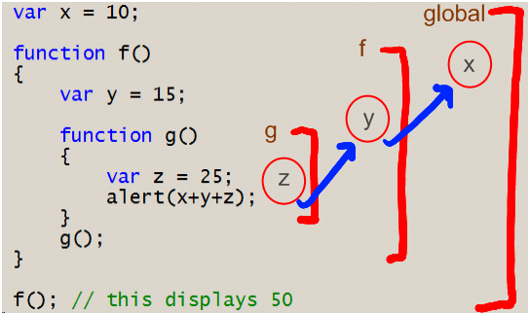
Closure Function
Closure means that an inner function always has access to the vars and parameters of its outer function, even after the outer function has returned.
Every function in JavaScript is a closure over at least one context: The global context.

Slide 11
Currying Function
Transformation of functions that callable as f(a, b, c) into f(a)(b)(c).
var curry = a=>b=>c=> console.log(a+b+c); (or)
var curry = function(a){
return function(b){
return function(c) {
console.log(a+b+c);
}
}
}
curry(1)(2)(3);
// 6

Slide 12
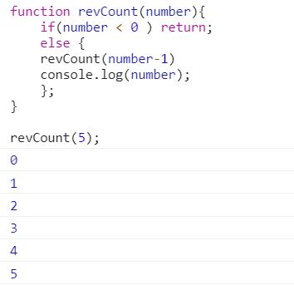
Recursive function

Slide 13
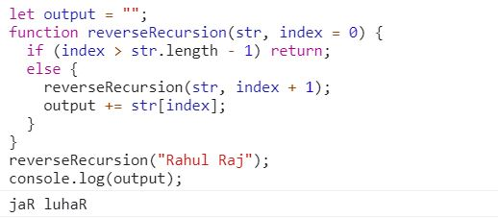
Recursive function

Slide 14
Objects

Slide 15
Objects
Every function in JavaScript is a Function object.
{} – Object Literal
Ways to create object in js
Let user = new user(); [using constructor fncn]
Let user = new user(); [using es6 classes]
Let user = {}; [using object literal]
Let user = Object.create(~objectName~) [using Object.create]
for in loop is used to iterate object.
in operator is used to check property exists or not

Slide 16
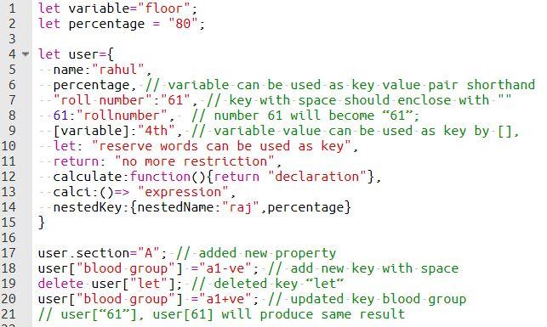
Program :

Slide 17
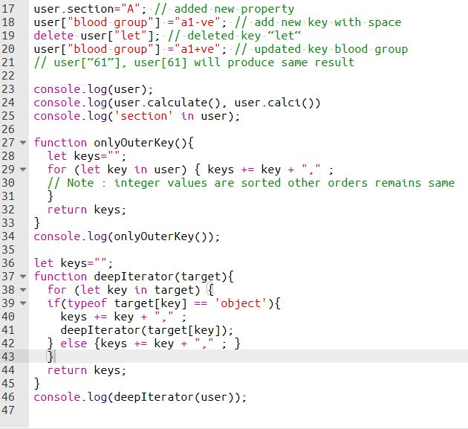
Program : continue

Slide 18
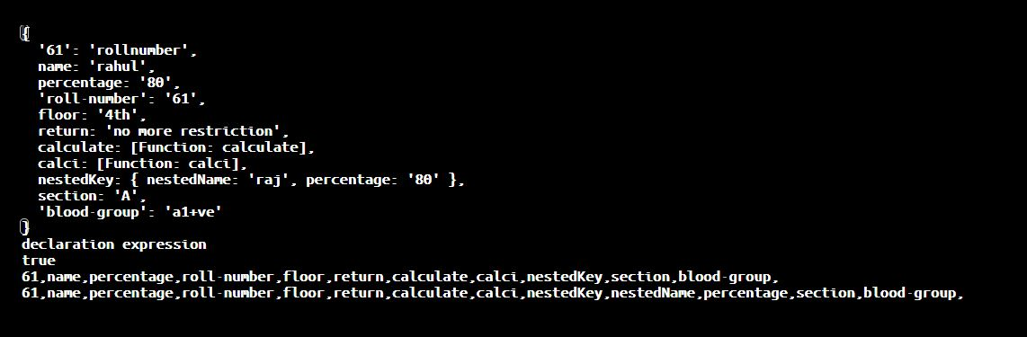
Output :

Slide 19
Shorthand property
// these objects do the same user = { sayHi: function() { alert("Hello"); } }; // method shorthand looks better, right? user1 = { sayHi() { // same as "sayHi: function(){...}" alert("Hello"); } }; console.log(user, user1) // both are same | // these objects do the same let percentage = "80" user = { percentage : percentage }; // property shorthand looks better, right? user1 = { percentage }; console.log(user, user1) // both are same

Slide 20
Cloning and Merging
let a={name:"raju"};
let b=a; // copy by its reference
b.name="ramu";
console.log(a.name,b.name, a===b);
// ramu ramu true
let src={name:"raju"};
let dest={};
Object.assign(dest, src); // if src & dest have same key will override
dest.name="ramu";
console.log(src.name,dest.name, src===dest);
// raju ramu false

Slide 21
Nested Cloning
//nested objects always copy its reference. So we need to perform some deep cloning by some additional packages or using traditional coding.
let user = {
name: "John",
sizes: {
height: 182,
width: 50
}
};
let clone = Object.assign({}, user);
alert( user.sizes === clone.sizes ); // true, same object
user.sizes.width++; // change a property from one place
alert(clone.sizes.width); // 51, see the result from the other one

Slide 22
“this” in methods
let user ={
name : "raju",
sayName(){
// “this” is the current object
console.log(this) //{ name: 'raju', sayName: [Function: sayName] }
console.log(this.name) //raju
this.name = "ramu";
}
}
user.sayName();
console.log(user.name); //ramu

Slide 23
Chaining “this”
let ladder = {
step: 0,
up() { this.step++; return this; },
down() { this.step--; return this; },
showStep() { alert( this.step ); return this; }
};
ladder.up().up().down().up().down().showStep(); //1
// just like currying function.

Slide 24
Optional Chaining ?.
Safe way to access nested object properties, even if an intermediate property doesn’t exist.
obj.val?.prop
//user.name?.fname
obj.val?.[expr]
//user.name?.[“first”+”name”]
obj.arr?.[index]
//user.arr?.[99]
obj.func?.(args)
//user.sayHi?.()

Slide 25
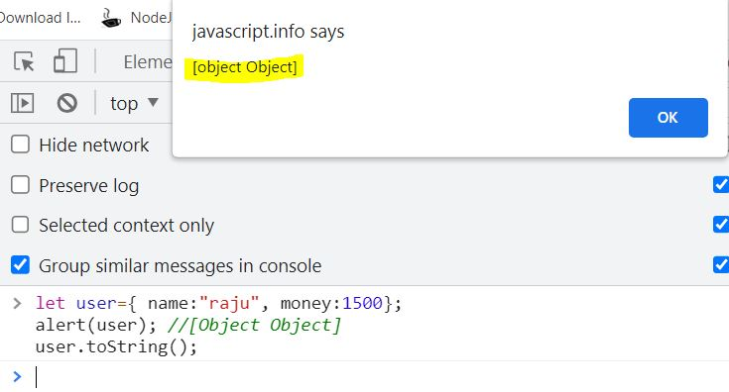
Object to Primitive Conversion
Issue:

Slide 26
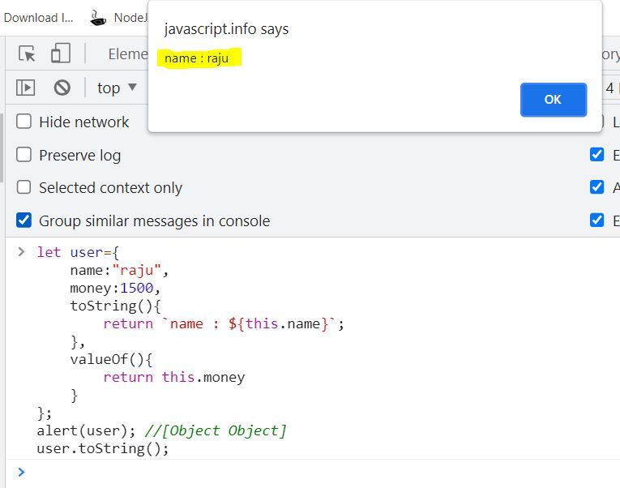
Object to Primitive Conversion
Solution:

Slide 27
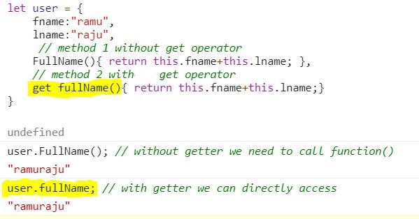
Accessor : Getter

Slide 28
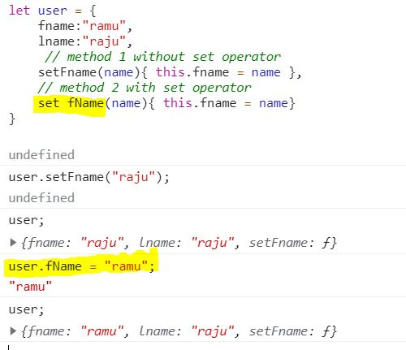
Accessor : Setter

